Slide 1
SweepBot: Floor Cleaner Robot
Project Update
Group No: 02
ID: 1906105
1906106
1906107
1906114
1906126
1806129

Slide 2
Working Procedure
We will use a sound source, and we will place it where the robot will clean.
The robot will move towards the sound.
While following the sound, the robot might come across some obstacles or walls. So, we will use the obstacle avoiding algorithm into it.
Then it will reach its destination.
After reaching the destination, a water pump will pump the water into the surface of the floor.
Then the mopper will be activated.

Slide 3
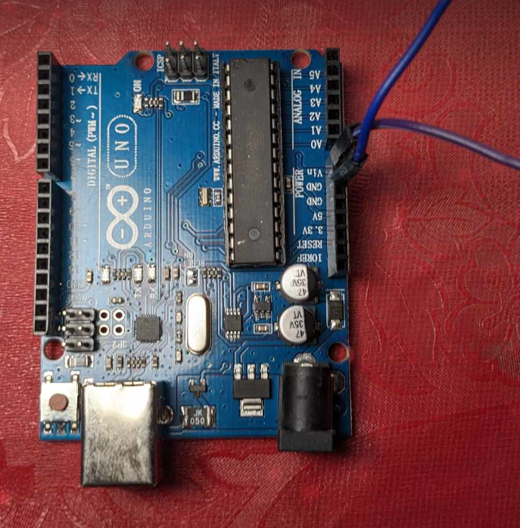
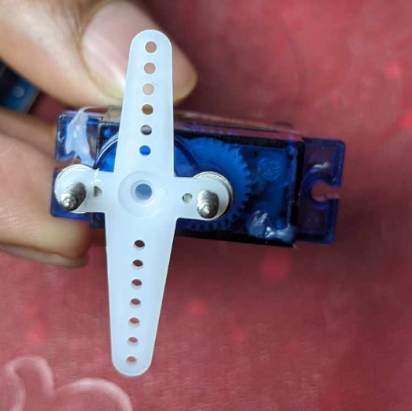
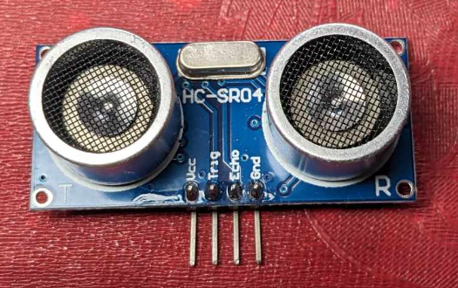
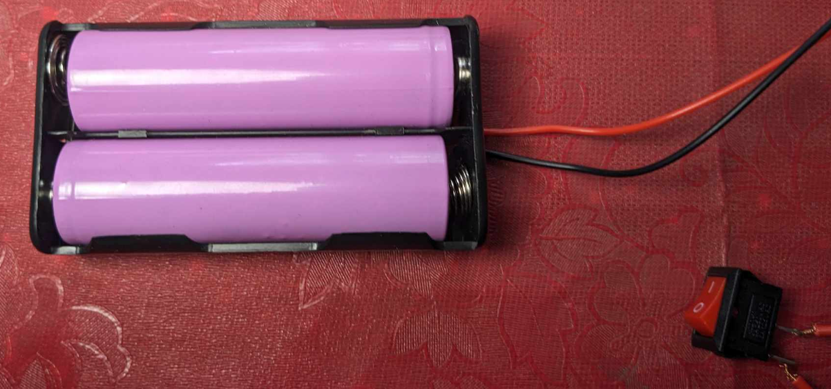
Components Bought
Arduino Uno R3
Motor driver L298N
Li-18650 battery
Motor gears
Wheels
Ultrasonic sensor
Servo motor SG-90

Slide 4
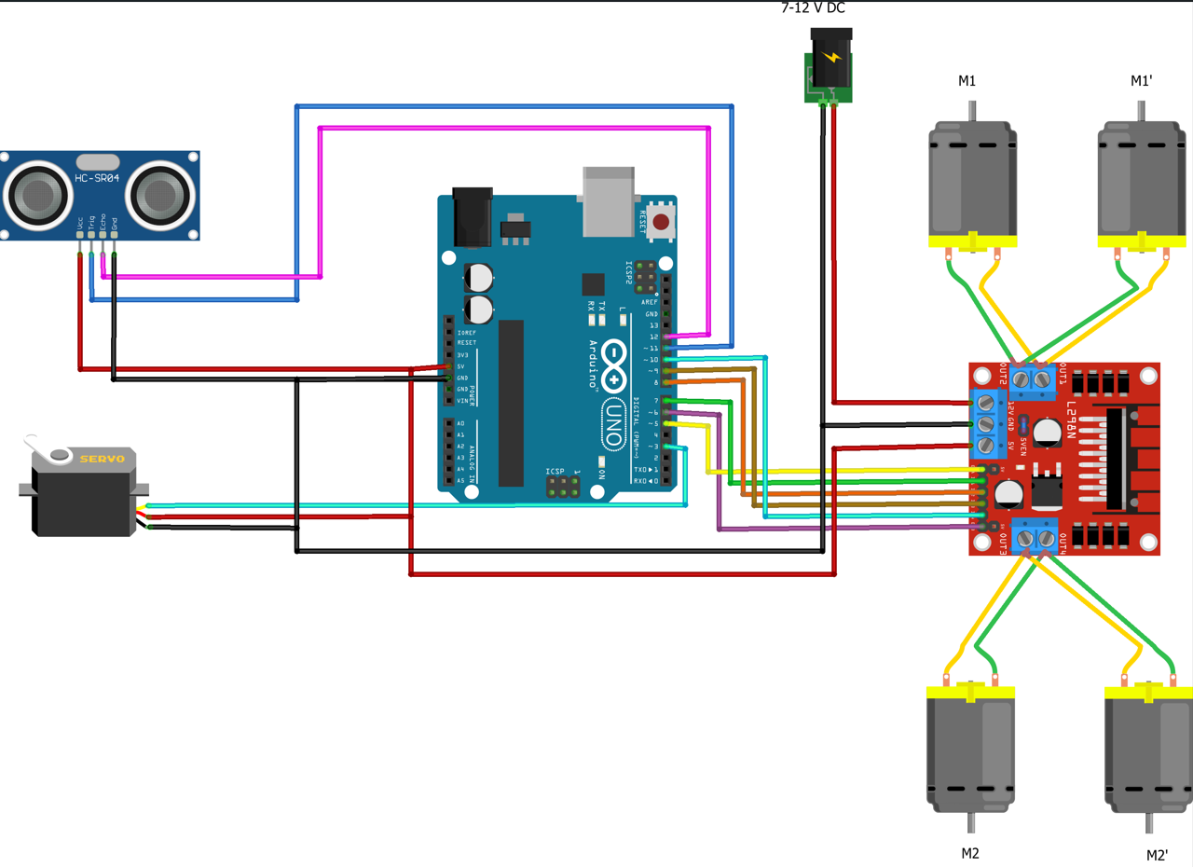
Our first step: Obstacle avoider
Circuit diagram for obstacle avoider:

Slide 5
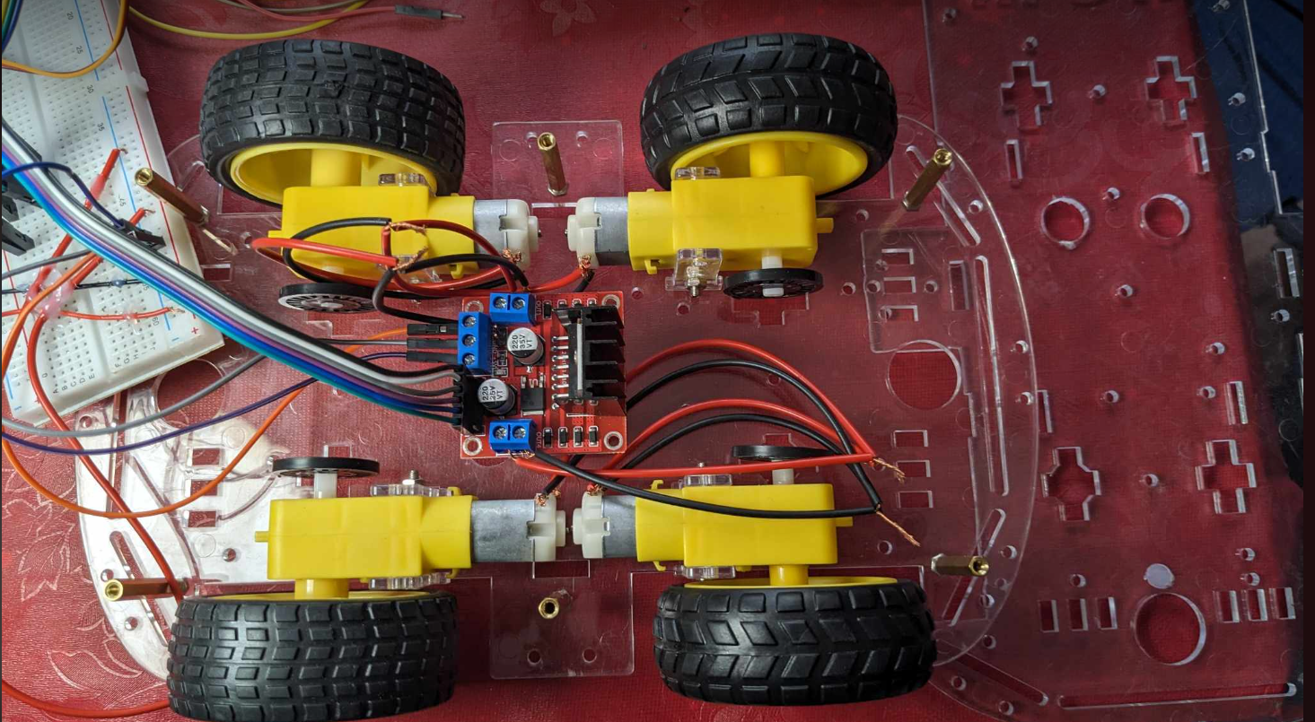
The car chassis

Slide 6
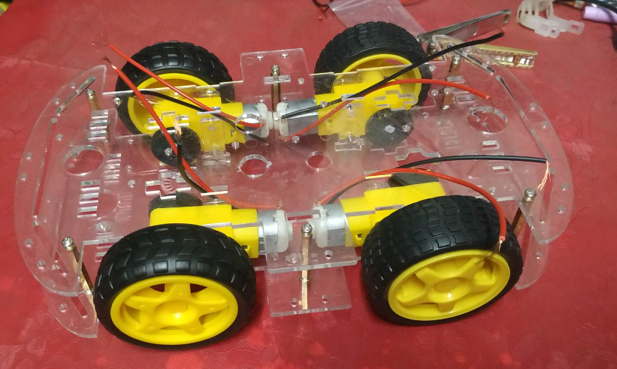
The infrastructure of the four wheeler

Slide 7
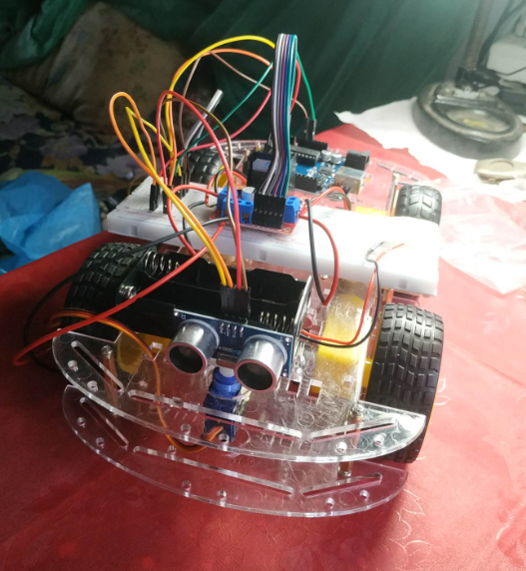
Final outcome
This is our ultimate obstacle avoiding robot-

Slide 8
Problems we faced
Since it is a hardware project, the whole project actually depends on the components.
After uploading the code into the Arduino board, the car was working for a few minutes. But then, our Arduino board got burnt. It was not working. So, we had to buy another Arduino board.
The second Arduino was working. The motor driver was drawing power from Arduino. But it was able to run three wheels. Another wheel was not moving at all.
We were also facing some problem with L293D motor driver shield. That is why, we switched to L298N motor driver.
With L298N motor driver, it was working fine for a few minutes. But then, it stopped working. So, in the video, we could not show the wheels moving in the video that we shot.

Slide 9
Our future works
We will fix our problems that we faced in the first part of this project.
Then we will integrate the sound following algorithm in it.
After that, we will install a motor pump and a mopper.
Finally, we will integrate that part also in our code.

Slide 10
Thank You!!!

